Slide 1
Introduction to
Presented By
James S. Godwin
Program Officer; One Health and Development
Initiative (OHDI)

Slide 2
WHAT iS alternative proteins africa?
Alternative Proteins Africa (APA) is a project of One Health and Development Initiative (OHDI) established as a resource hub and platform to promote knowledge, information, advocacy, research, innovations and movement building for the growth and advancement of the alternative protein sector in Africa.
It is a COMMUNITY!

Slide 3
why alternative proteins Africa?
Increased animal agriculture which is impacting human health, climate change, zoonoses, poor animal welfare and other One Health issues
Poor public awareness, understanding or perceptions of alternative proteins and their benefits to human health, animal welfare, and ecosystem sustainability.
Compared to other continents and countries, lower proliferation of innovations, start-ups, technology and investments in the alternative protein sector in Africa

Slide 4
goals OF Alternative protein africa
Bridge the knowledge gap on AP in Africa.
Collate and provide globally-relevant information on AP.
Promote, advocate, and support people through transitioning into diets that support alt protein to animal protein sources.
Enhance local innovations on alternative proteins and supplies from local resources in Africa.
Support commercialization and businesses in the AP sector.

Slide 5
Expected impacts OF Alternative protein africa
Increased awareness, knowledge and acceptability of AP in Africa.
Strengthen partnership and collaboration between stakeholders.
Increased adoption of alternative protein and less animal food sources.
Increased innovation and investments in alternative protein in Africa.

Slide 6
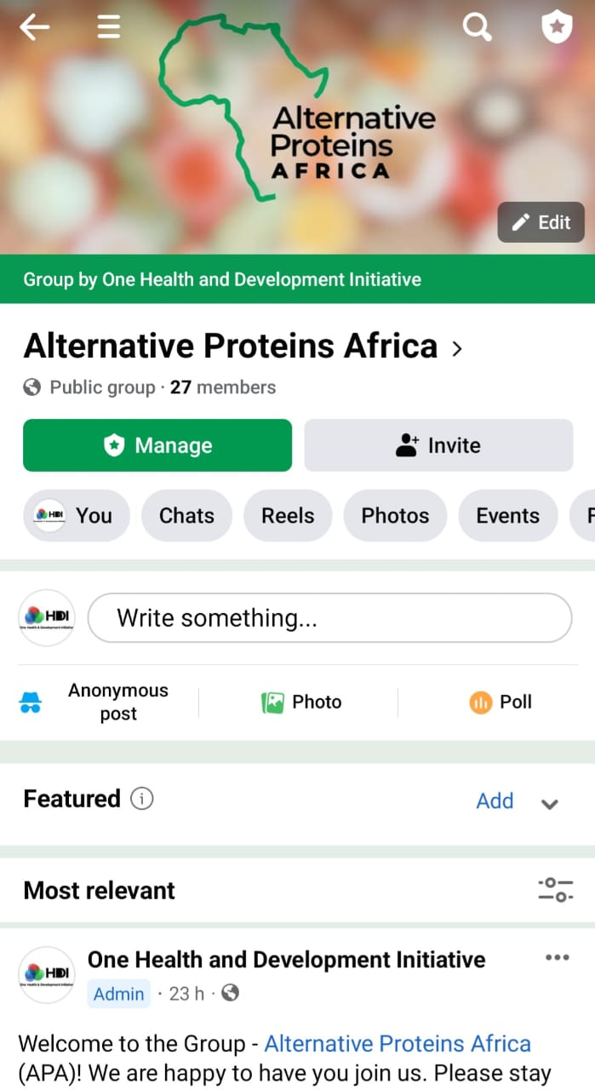
Engagement will be driven by digital media platforms & on-site activities where relevant
Twitter: @altproafrica
Instagram: @alternativeproteinsafrica
LinkedIn: Alternative Proteins Africa
Website: www.alternativeproteinsafrica.com
Email: james@onehealthdev.org; kiki@onehealthdev.org

Slide 7
FACEBOOK COMMUNITY

